Slide 1


PWAs with Angular
Angular Athens, 4th meetup
Blurring the lines between native and web apps
George Kalpakas
@gkalpakas

Slide 2



George Kalpakas
Angular core team
gkalpak
@gkalpakas

Slide 3
What
is a Progressive Web App (PWA)?

Slide 4

PWA is a collection of characteristics:
PWAs: Escaping Tabs Without Losing Our Soul
Progressive Work for any user. Progressively enhanced.
Responsive Fit any form factor.
Linkable Zero-friction, zero-install, easy to share. The social power of URLs matters.
Safe Served via TLS to prevent snooping.
App-like interactions Shell + Content app model to create “appy” navigations & interactions.
Fresh Transparently always up-to-date.
Discoverable Identifiable as “apps”, allowing search engines & app stores to find them.
Connectivity independent Work offline or on unreliable connection.
Re-engageable Access the re-engagement UIs of the OS.
Installable Integrate with OS (e.g. on home screen). “Keep” useful apps without the app store hassle.
Alex Russell, 2015

Slide 5
Why
should you care?

Slide 6
The better User eXperience an app offers…
...the better it can fulfill its purpose.
(For any app type: commercial, gaming, productivity, etc.)

Slide 7
Mobile web vs native apps
Source: Comscore Mobile Metrix®, 2015-2017
10M
Much broader reach!
Much higher engagement!
250min
8M
8.9M
200m
201.8min
6M
150min
4M
100min
3.3M
2M
50min
10.9min
0M
0min
Apps
Web
Apps
Web
Monthly unique visitors
Avg. monthly minutes per visitor

Slide 8





Write once…
...run anywhere?
Use the Platform, Luke.
Web is THE platform!*
(* with caveats but still…)

Slide 9

In Summary
A PWA offers:
Great UX.
Broad reach.
High engagement.
Low development/maintenance cost.

Slide 10
Where
can PWAs be used?

Slide 11






Browsers:
Browsers
Mobile
Desktop

Slide 12


Browsers:
Mobile:
Browsers
Mobile
Desktop

Slide 13




Browsers:
Mobile:
Desktop:
Browsers
Mobile
Desktop
OS
72

Slide 14
Browsers:
Mobile:
Desktop:
Browsers
Mobile
Desktop
OS
72
Reminder
Progressive enhancement Still work on old browsers

Slide 15
How
can we build a PWA?

Slide 16
PWAs have to be:
Progressive
Responsive
Linkable
Safe
App-like interactions
Progressive
Responsive
Linkable
Safe
App-like interactions
Using
traditional technologies
Fresh
Discoverable
Connectivity independent
Re-engageable
Installable
?

Slide 17
New browser APIs:
Service Worker + Fetch
Fresh
Web App Manifest
Discoverable
Service Worker + Cache + IndexedDB
Connectivity independent
Service Worker + Clients + Notifications + Push
Re-engageable
Service Worker + Web App Manifest
Installable

Slide 18
New browser APIs:
Service Worker + Fetch
Fresh
Web App Manifest
Discoverable
Service Worker + Cache + IndexedDB
Connectivity independent
Service Worker + Clients + Notifications + Push
Re-engageable
Service Worker + Web App Manifest
Installable

Slide 19
Service Worker (SW)

Slide 20



Without service worker
Browser
Web
Managed by the browser
Browser cache

Slide 21

With service worker
Client
Browser
SW
Web
Managed by the SW => us
Browser cache
Cache, IndexedDB

Slide 22

Server-initiated push
Browser
SW
Web
Push
Notifications
OS notification

Slide 23
SW code: Installation / Activation
self.addEventListener('install', event => {
// E.g. populate caches with new resources.
event.waitUntil(doAsyncStuff());
});
self.addEventListener('activate', event => {
// E.g. clean up old caches.
event.waitUntil(doAsyncStuff());
});
\

Slide 24
SW code: Requests
self.addEventListener('fetch', event => {
// E.g. forward the request to the server
// or retrieve a response from the cache
// or come up with a random response ¯\_(ツ)_/¯
event.respondWith(someResponse);
});
\

Slide 25
SW code: Other events
self.addEventListener(
'message/notificationclick/push/...',
event => {
// Handle the event.
event.waitUntil(doAsyncStuff());
},
);
\

Slide 26
Web App Manifest

Slide 27

Web App Manifest:
Simple JSON text file.
Provides information about the app (e.g. name, icons, description).
Helps identify a web app as PWA.
Helps better integrate with OS.

Slide 28
manifest.json
index.html
{
"name": "My PWA",
"description": "...",
"start_url": ".",
"display": "standalone",
"theme_color": "orchid",
"icons": [...],
...
}
<link
rel="manifest"
href="manifest.json"
/>

Slide 29
PWA-related Tooling

Slide 30

Note of caution
Low-level, powerful APIs:
Easy to shoot oneself in the foot.
Using tools ensures:
Battle-tested solutions.
Best practices.
Not re-inventing the wheel.

Slide 31

Building PWAs (1/3)
PWABuilder
Online wizard and CLI tool for generating PWA from any site.
Additionally supports packaging PWAs as native apps (via Cordova).
Good for initial experimentation.
Easy to get started, extensible
Limited feature-set

Slide 32

Building PWAs (2/3)
Workbox
Set of libraries and Node modules for building PWAs.
Plugin-based architecture.
Supports extending existing SW.
Feature-rich, extensible, composable
Relatively complicated set-up

Slide 33

Building PWAs (3/3)
@angular/service-worker
Angular‘s SW implementation.
Offers several features out-of-the-box.
Angular & Angular CLI integration.
No coding required, easy to use from Angular app (DI, services)
Not extensible/composable

Slide 34

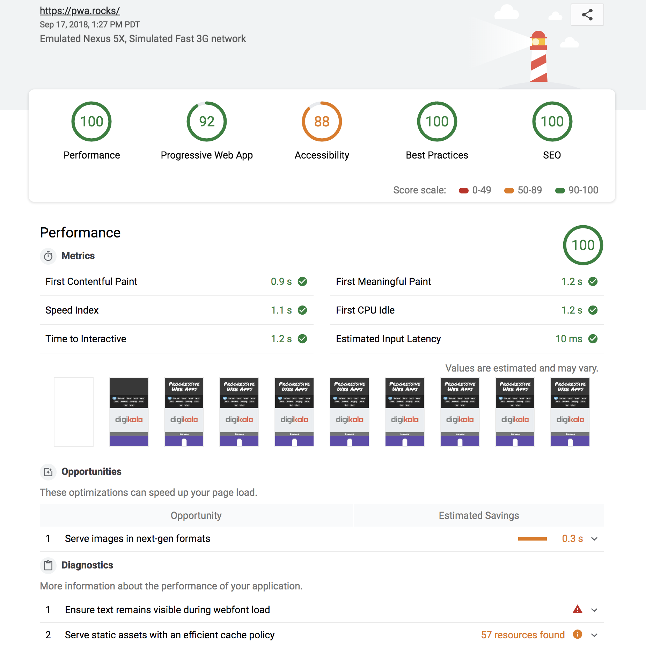
Testing PWAs (1/2)
Lighthouse
Open-source, automated tool for improving quality of web pages.
Audits for PWA, performance, accessibility, and more.
Built into Chrome. Useful during development.
CLI tool / Node module. Useful for CI.

Slide 35

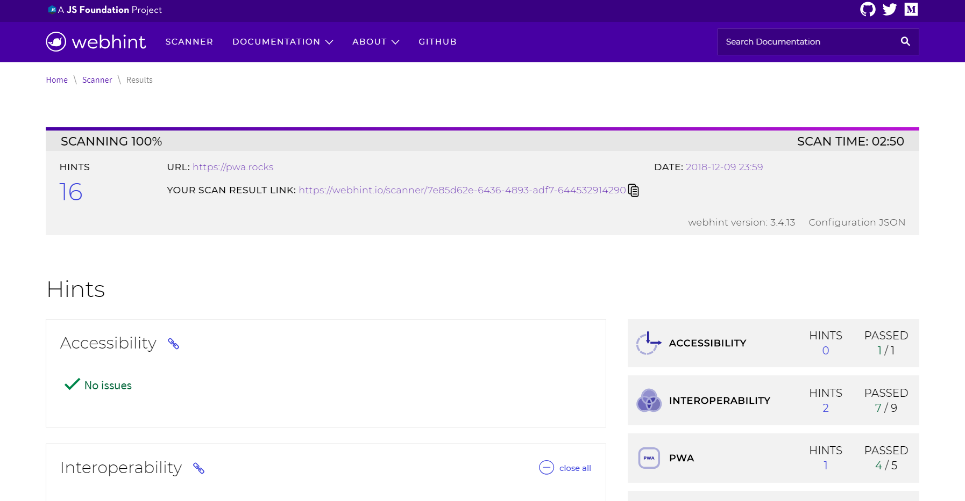
Testing PWAs (2/2)
Webhint
Open-source, community-driven linting tool.
Helps improve speed, accessibility, security, PWA, and more.
Checks for best practices and common errors.
Online scanner. Useful during development.
CLI tool. Useful for CI.

Slide 36
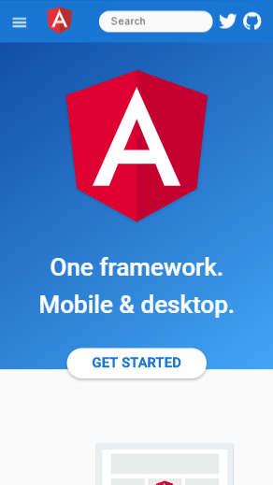
Demo time!
https://github.com/gkalpak/ng-athens-pwa-demo
Place your screenshot here

Slide 37

Thank You!
Slides | bit.ly/gk-ngathens-pwa
George Kalpakas
@gkalpakas

Slide 38
Resources: Browser APIs
Stable APIs:
Cache API
Clients API
Fetch API
IndexedDB API
Notifications API
Push API
ServiceWorker API
Web App Manifest
Proposed/Draft APIs:
Background Fetch
Background Sync
Writable Files
Miscellaneous:
Is Service Worker ready?
Project Fugu (successor of Project Fizz)

Slide 39
Resources: Tooling/Docs
Tooling:
Angular SW: Intro
Angular SW: Config
Workbox
PWABuilder
Lighthouse
Webhint (prev. Sonarwhal)
Guides/Blog posts:
PWAs
Desktop PWAs
PWAs and Windows 10
Debugging Service Workers
PWAs: Escaping Tabs Without Losing Our Soul Alex Russell, 2015 - Introducing PWAs

